Slide 1
Microcomputer Design: The Final Product
Richard Homan – Spring 2024

Slide 2

Project Hardware Requirements
Serial communication
USB Serial
RS-232
64 KB RAM
64 KB address space
On-board storage of monitor program
ROM
No kits

Slide 3

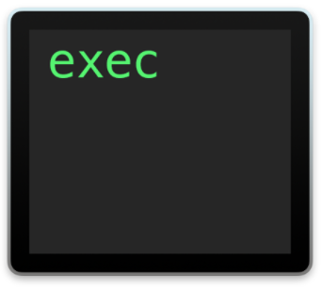
Project Software Requirements
Stored onboard
Read/Write to registers
Read/Write to memory
Load/Execute an external executable file
SREC (Motorola S-Record)

Slide 4

Personal Requirements
Compact design
Debug-able design
Exposed control lines
Ability to change circuitry if necessary
Non-free-range software
Single port connectivity
Professional aesthetic
Interrupt capable
Memorable name

Slide 5
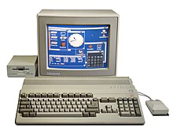
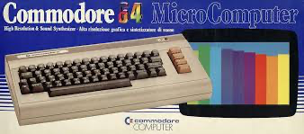
Commodork Enemigo -64
Spin-off of a set of Commodore computers
Models of influence
Commodore Amiga 500
Commodore 64
Amiga used M68k

Slide 6
Technical

Slide 7
Hardware Block Diagram

Slide 8




Major Parts List
MPU: Motorola 68000
CPLD: Xilinx XC9572XL
RAM: 2x MCM6206CP35
32 kilobyte SRAM
ROM: 2x AT28C256
32 kilobytes
Serial
Motorola 68681 DUART
FTDI FT230XS-R

Slide 9
Hardware Schematic

Slide 10
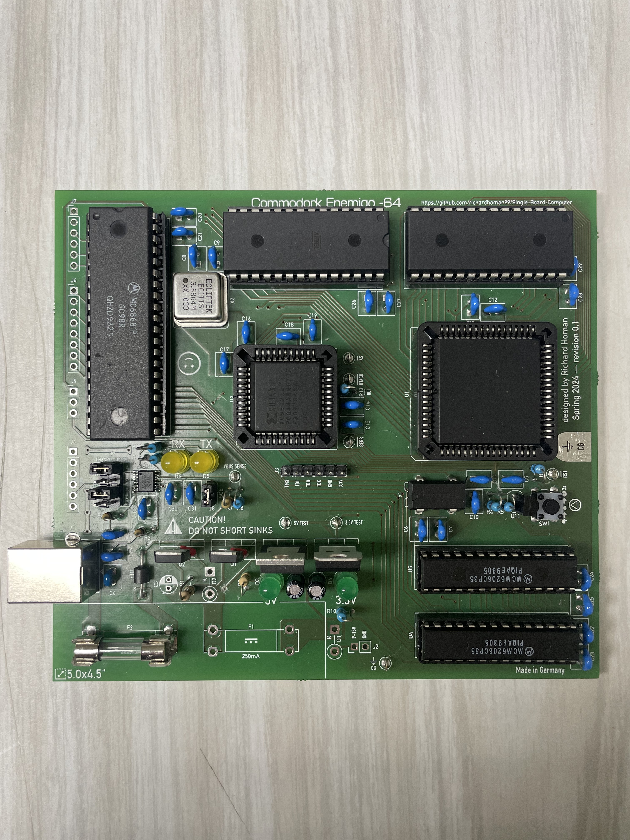
PCB Layout
ROM low
ROM high
68681 DUART
Serial → USB
Converter
M68k MPU
CPLD
RAM high
USB-B Port
RAM low

Slide 11
Software ↔︎ Hardware Bridge
Xilinx CPLD
Doesn’t let the software run free-reign
Most time consuming development process
(Not much to show here, unless you want to see code…)

Slide 12

Monitor Software
EMS: “Enemigo Monitor System”
Written in C
Thanks to GNU bin-utils and gcc
Learned how the C runtime operates
About 7kB (6,608 bytes)
Has capability to handle interrupts
(You don’t want to read 28 source files with a cumulative line count of 1,902)

Slide 13
Monitor Abstract Process
Initialize DUART
Get User Input
Get User Input
Determine command
Execute Command
Poll DUART for input characters
Hash user input
Get command function
Execute command function
Print error status

Slide 14
Project Management

Slide 15
Cost Breakdown
Used as many available parts from lab as possible
Group ordered parts with 2 other peers
Had board made in Germany instead of Hong Kong
Item | Cost | Shipping | Subtotal
Parts (redundant) | 53.55 | 9.49 | 63.04
PCB Manufacturing | 35.47 | 16.18 | 57.87
Totals | 89.02 | 25.67 | 120.91

Slide 16
Cost Breakdown
 | Good Cost | Shipping Cost | Shipping to Total Costs Ratio
Parts | 53.55 | 9.49 | 15%
PCB | 35.47 | 16.18 | 31%
Total | 89.02 | 25.67 | 22%

Slide 17
Time Breakdown

Slide 18
Total Time Spent
216 Hours
in 12 Weeks

Slide 19
The Process In Pictures

Slide 20
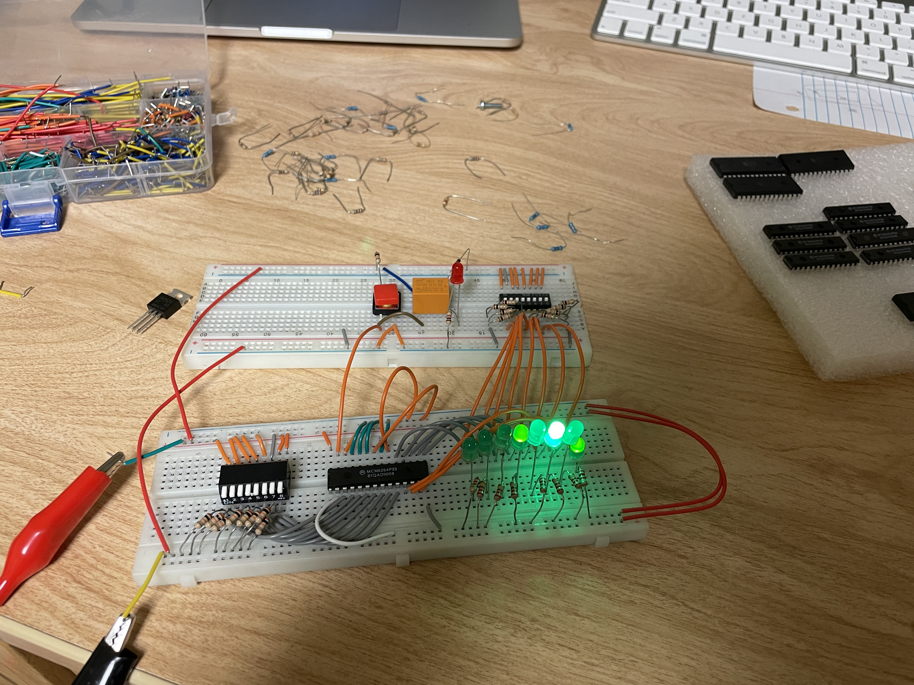
Tinkering with SRAM Chips

Slide 21
Reading Datasheets Creating Schematic Creating PCB

Slide 22
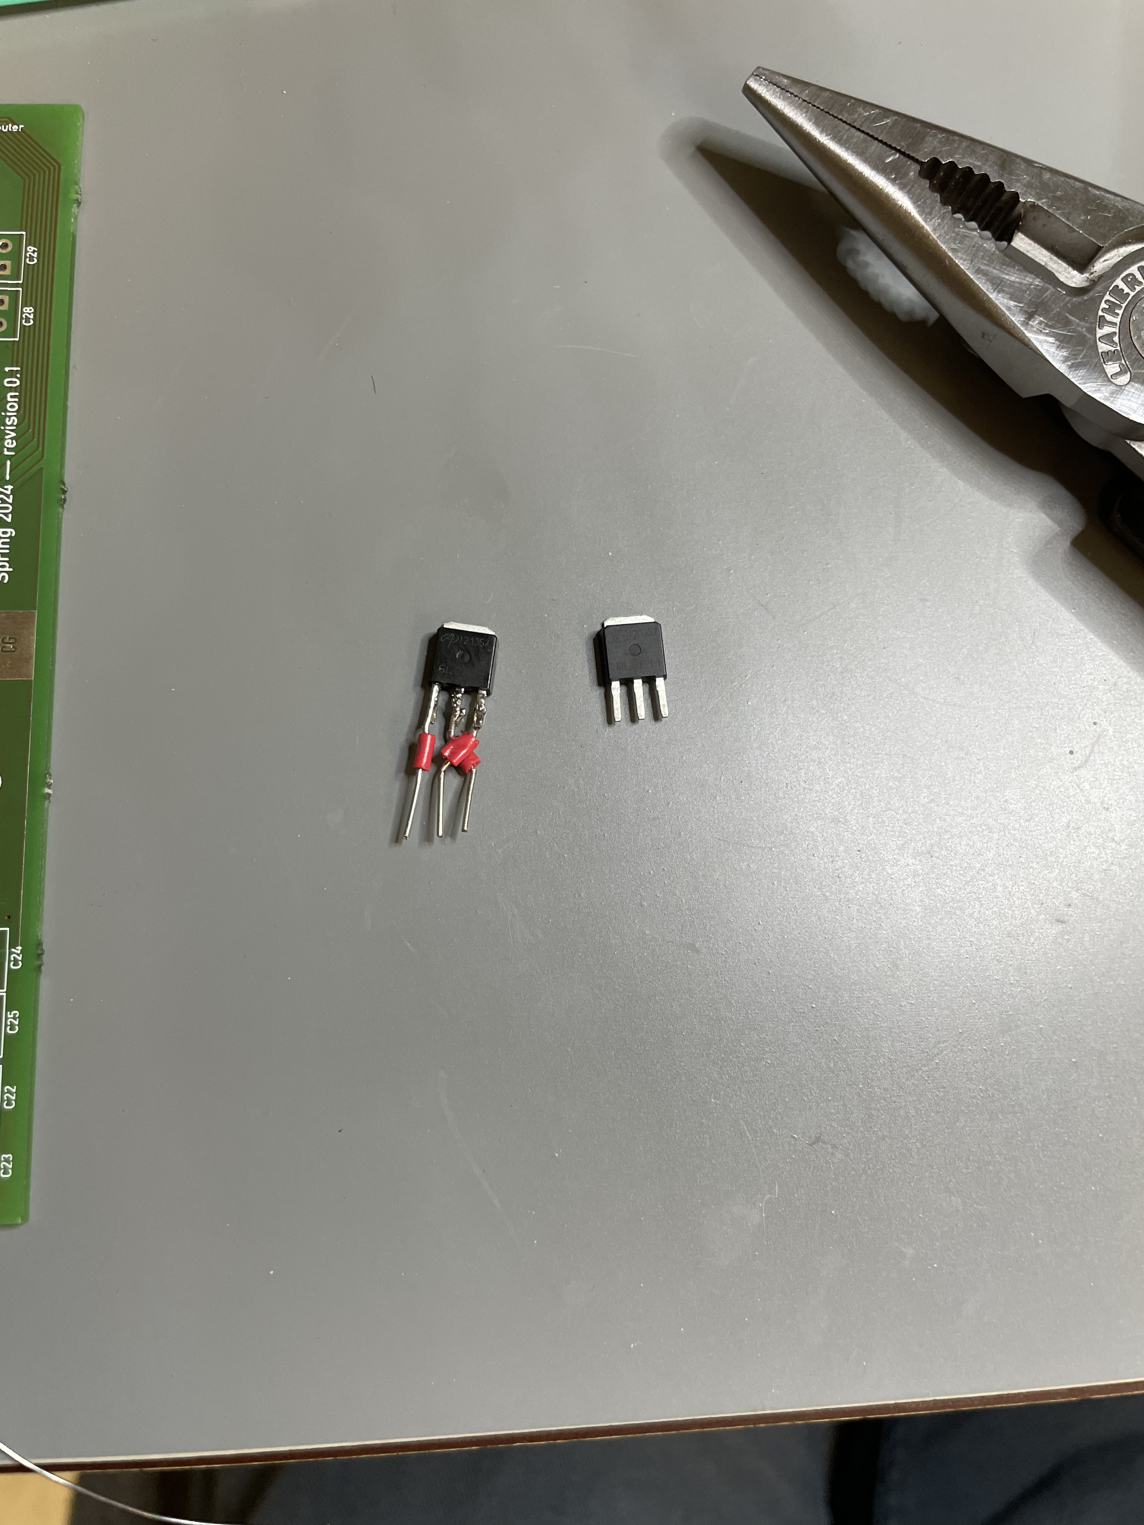
Modifying MOSFETs

Slide 23
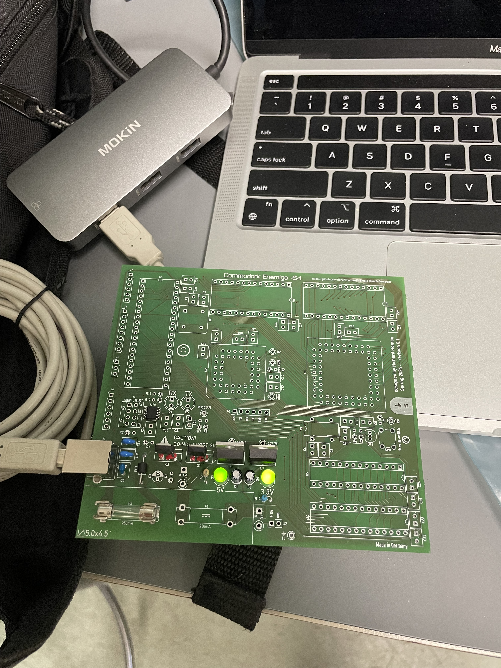
First Power Up

Slide 24
Soldering Hardware debugging Software debugging

Slide 25
Final Product

Slide 26


DEMO

